Slide 1
Qualitative Changes in Equilibrium Systems
Lesson 3
7.4

Slide 2
Le Châtelier’s Principle:
A generalization that states that chemical systems at equilibrium shift to restore equilibrium when a change occurs that disturbs the equilibrium.
predicts the way that an equilibrium system responds to change in
Concentration
Temperature
Volume and Pressure (if you increase volume pressure will decrease)

Slide 3
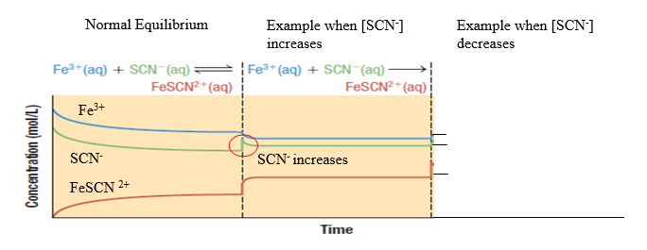
Changes in Concentration
Equilibrium Shift – A change in concentrations of reactants and products in order to restore an equilibrium state.
Adding Reactant
Increasing the concentration of a reactant will shift the equilibrium to the right, to compensate for this change.
The reaction will now proceed in the forward reaction to get back to an equilibrium state.

Slide 4
Changes in Concentration
Removing Reactant
Decreasing the concentration of a reactant will shift the equilibrium to the left, to compensate for this change.
The reaction will now proceed in the reverse reaction to get back to an equilibrium state (shift towards the reactants)

Slide 5
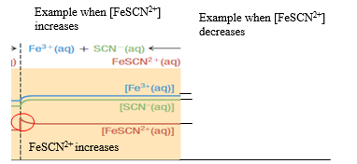
Changes in Concentration
Adding Product
Increasing the concentration of a product will shift the equilibrium to the left, to compensate for this change.
The reaction will now proceed in the reverse reaction to get back to an equilibrium state.
Decreasing Product
Decreasing the concentration of a product will shift the equilibrium to the right, to compensate for this change.

Slide 6
CHANGES IN TEMPERATURE
A system at equilibrium will also shift when it is disturbed by the addition or removal of energy. Example: Change in temperature.
To understand this concept let’s treat energy as a reactant or a product. Write the thermochemical equation.

Slide 7
Endothermic Reactions
Decrease in Temperature
If an endothermic reaction is cooled (thermal energy removed), we can consider that the quantity of one of the reactants has been decreased.
The equilibrium will shift to the left (reverse reaction) to make more energy to compensate for the loss of energy
Increase in Temperature
If an endothermic reaction is warmed (thermal energy gained), we can consider that the quantity of one of the reactants has been increased.
The equilibrium will shift to the right (forward reaction) to use up energy to compensate for the gain in energy

Slide 8
Graphical representation of temperature changes for Endothermic Reaction
Temperature increase
Temperature decrease
[N₂O₄]
[NO₂]

Slide 9
Exothermic Reactions
Decrease in Temperature
If an exothermic reaction is cooled (thermal energy removed), we can consider that the quantity of one of the products has been decreased.
The equilibrium will shift to the right (forward reaction) to release energy that is stored in the reactants.
Increase in Temperature
If an exothermic reaction is warmed (thermal energy added), we can consider that the quantity of one of the products has been increased.
The equilibrium will shift to the left (reverse reaction) to use up energy to compensate for the gain in energy.

Slide 10
Graphical representation of temperature changes for Exothermic Reaction
Temperature increase
Temperature decrease
[N₂O₄]
[NO₂]

Slide 11
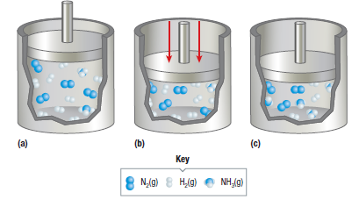
CHANGES IN GAS VOLUME
Reminder: Boyle’s Law: A decrease in volume results in an increase in pressure
When the volume of a container is decreased, the concentration increases proportionally to the increase in pressure.

Slide 12
CHANGES IN GAS VOLUME
Consider the following reaction:
If the volume decreases the reaction will shift to right (forward reaction) because there is less gas molecules (4:2) which would then increase the pressure.
Rules:
If volume decreases or pressure increases it shifts to the side that has less moles
If volume increases or pressure decreases it shifts to the side that has more moles

Slide 13
The Following have no Effect on the Equilibrium Position:
CATALYSTS
In reversible reactions, catalysts increase the reaction rates of the forward and reverse reactions equally.
Therefore, a catalyst does not change the equilibrium position
INERT GAS
An inert gas is a gas that is not reactive and so will not enter into a chemical reaction. Ex. Noble Gases – Helium (any Noble gases in the periodic table)
Adding an inert gas to a container increases the total pressure of the system but has no effect on the equilibrium concentrations of reactants and products since their partial pressures are not changed.
STATE OF REACTANT
When a chemical system involves entities in more than one state of matter, equilibrium is affected only be changes in concentration of entities that are in the same state of matter as the substance involved in the chemical reaction system.

Slide 14
PRACTICE
Apply Le Châtelier’s Principle: Example Problem #1
Consider the following reaction: N_{2(g)} + 3H_{2(g)}  2NH_{3(g)} ∆H = -92kJ/mol
In which direction does the equilibrium shift as a result of each change?
Adding N_{2(g)}?
Removing NH_{3(g)}
Increasing temperature?
Increasing pressure?
Using a catalyst?
Adding Ne_{(g)}?
Right
Right
Left
Right
No change
No change

Slide 15
Homework
Complete the La Châtelier's assignment and hand in before you leave today.
Extra questions are attached to your handout for practice. Graph these reactions and the changes.

